Slide 1


Visionary Course - Energy AI
Week 11
May 13, 2022
Giwon Sur

Slide 2


https://view.kentech.ac.kr
Week 11a – Inference for road following on Jetson Nano

Slide 3
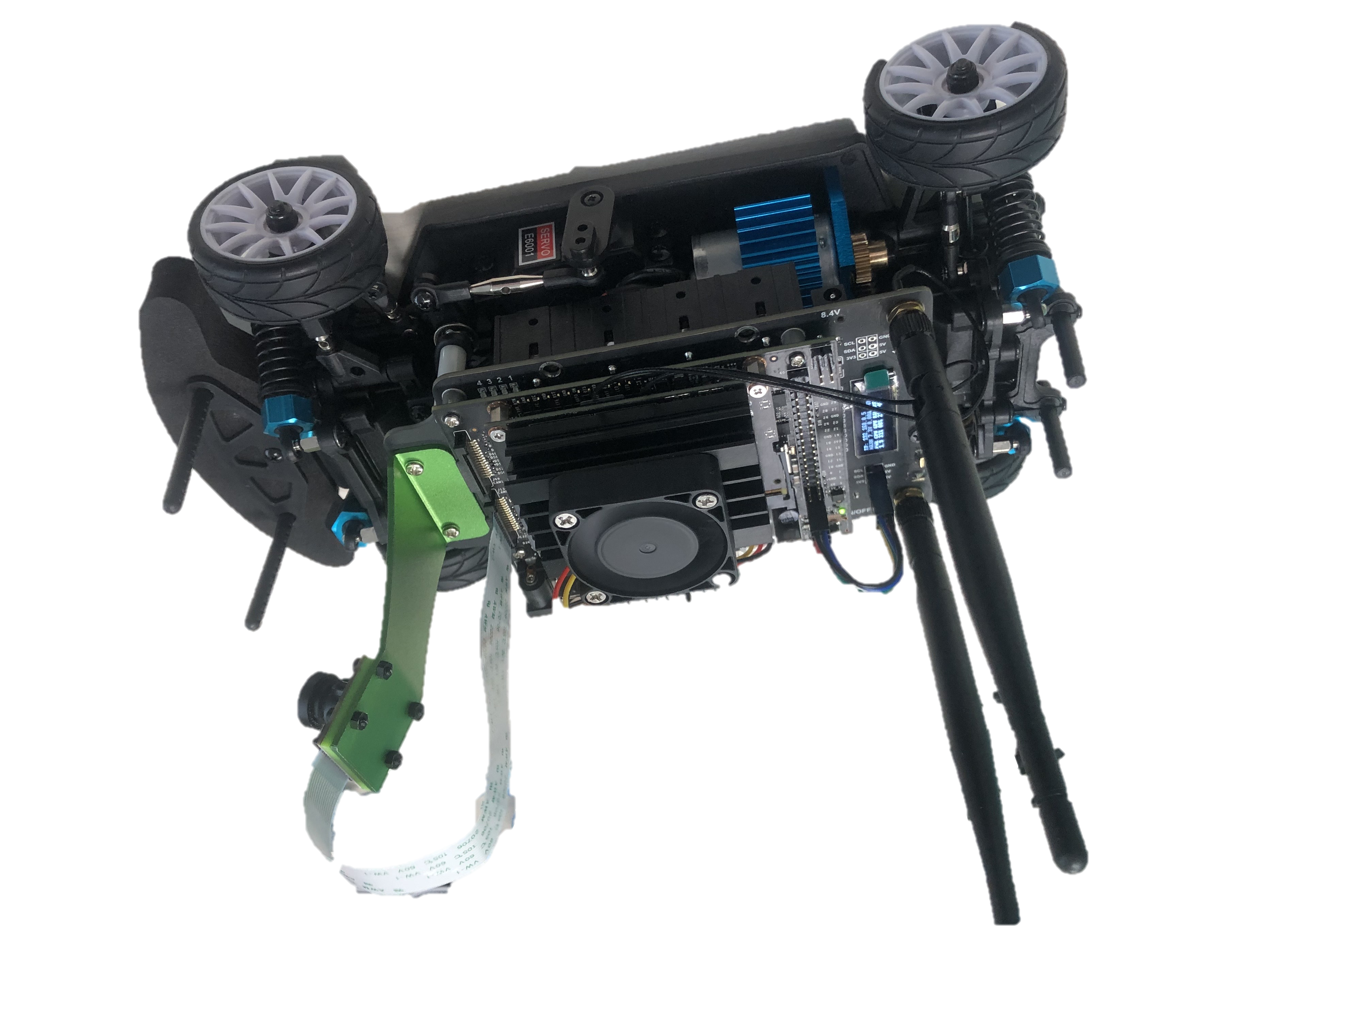
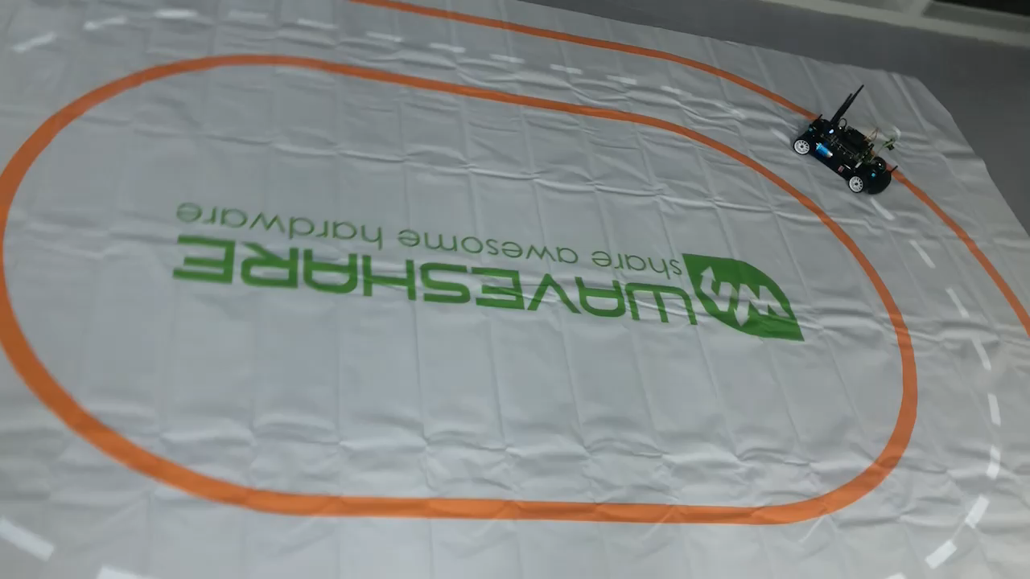
JetRacer: Let's start autonomous driving!
Today we will test the pretrained model on the road with 2D-lined track.
Workspace:
“localhost:8888/lab/tree/jetracer/notebooks/road_following.ipynb”

Slide 4
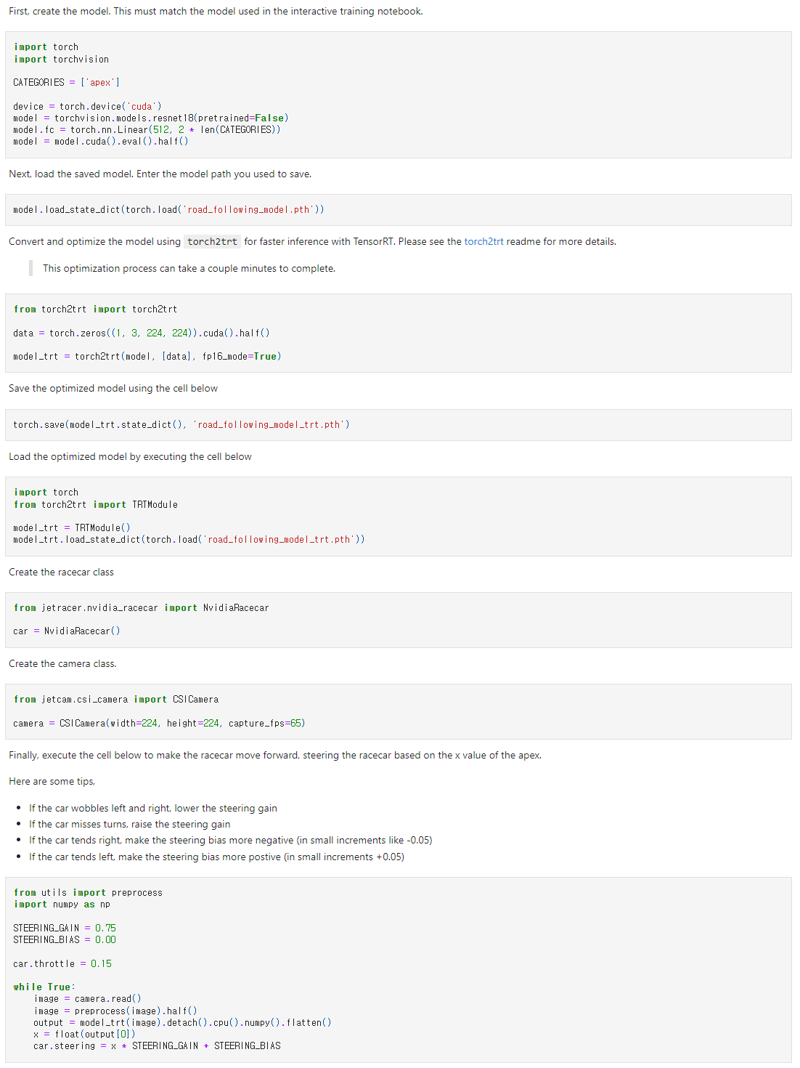
Overview of road_following.ipynb
1
Define model
Configure
racecar & camera
2
3
Iterative inference
4
Load pretrained model
Notes:
Road_followin의 전체적인 overview
4. 모델을 통해 추론한다.

Slide 5
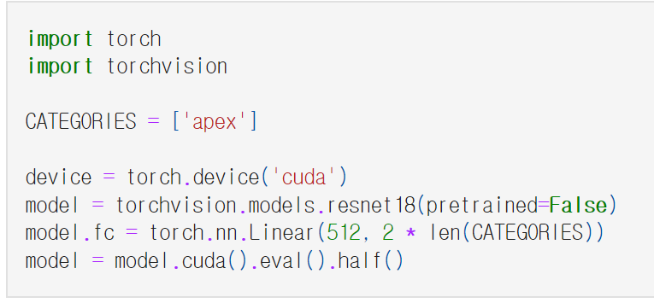
1. Define model
Import modules to define model
‘apex’ directs a point with x, y coordination
in camera image
Declare resnet18 to define model
Set fc layer’s output size as 2 (x, y)
Set data type to float16
Set model’s mode as evaluation
Load model to GPU
Notes:
Tensor.half(memory_format=torch.preserve_format) → Tensorself.half() is equivalent to self.to(torch.float16). See to().
Lets

Slide 6
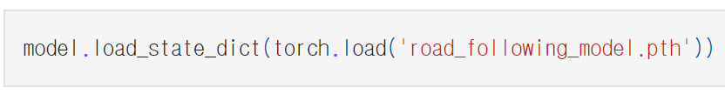


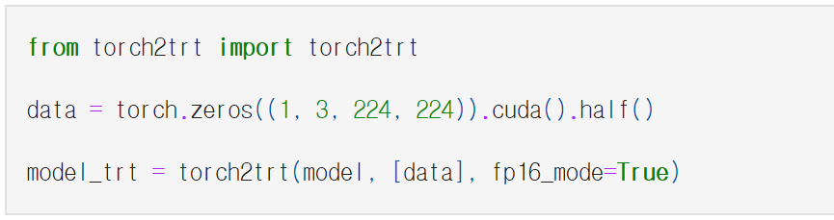
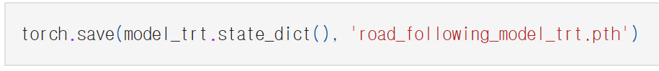
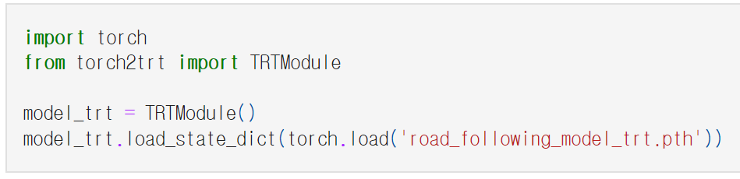
2. Load pretrained model
Load pretrained model from '~.pth’ file.
model(resnet18)
Import Torch2trt for better performance
Declare sample data with the same size as target data
Convert model from pytorch to TensorRT
Save converted model parameters
Declare trt model which stores the original model
Load saved model parameters
Notes:
https://nvidia-ai-iot.github.io/torch2trt/v0.3.0/usage/basic_usage.html

Slide 7
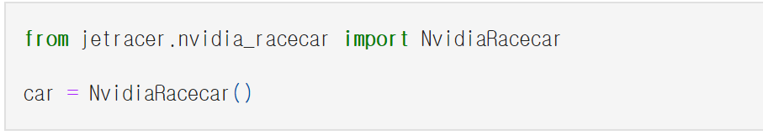
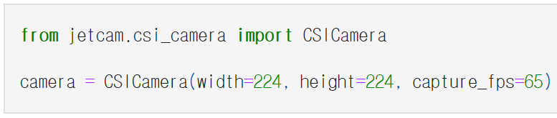
3. Configure race car and camera
Create race car class
Create camera class

Slide 8
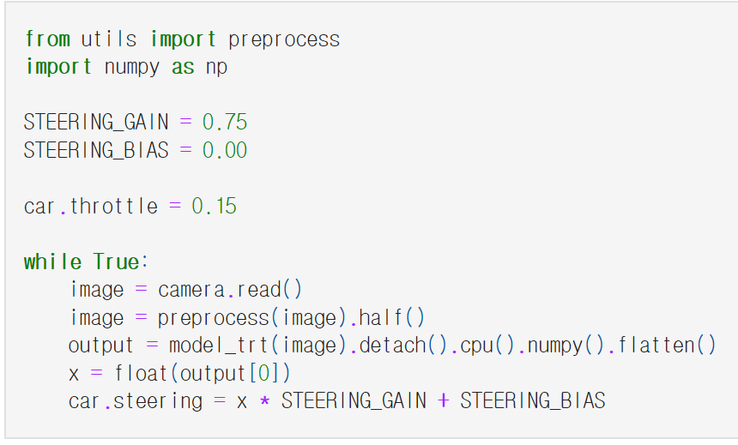
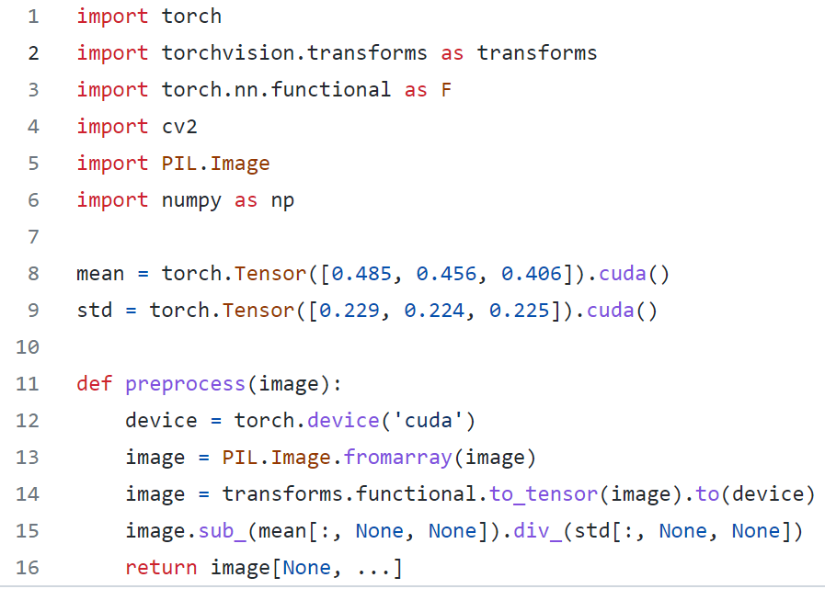
4. Iterative inference
Set fixed multiplier and adder for steering
Set throttle to fixed value
Read real-time image from camera
Feed image values and get the output from the model
From output, car inferences steering value
Return normalized image values

Slide 9
Experiments :
Upload pretrained model.
Q.1.1. Download trained model “road_following_model_gwsur.pth“ from LMS.
Q.1.2. Visit to localhost:8888/lab/tree/jetracer/notebooks/road_following.ipynb
Q.1.3. Upload the model pth file and write the models name on code model.load_state_dict(torch.load('road_following_model_gwsur.pth'))
Observe and execute the model.
Q.2.1. Unfold the track in suitable place. And put the car on the track.
Q.2.2. Run codes along with the cell.
Q.2.3(optional). Reference and use “teleoperation.ipynb” code to prevent missing car.
Q.2.4. Observe the car’s trace. Are the steering and throttle are suitable?
Q.2.5. Control the value of throttle (slower or faster).

Slide 10
Experiments :
Make variable environments and execute the model.
Q.3.1. Place the car in opposite direction of Q2 and execute model.
Is the model following the road similar?
Q.3.2. Place a small obstacle on the road. How’s the car doing?

